Slide 1
JPG GRAYSCALE IMAGE EDGE DETECTION
Team Member: Haobo Chen
Ni Kang
Haoming Zhang
TA: Reena Elangovan
1
Notes:
Ni Kang

Slide 2
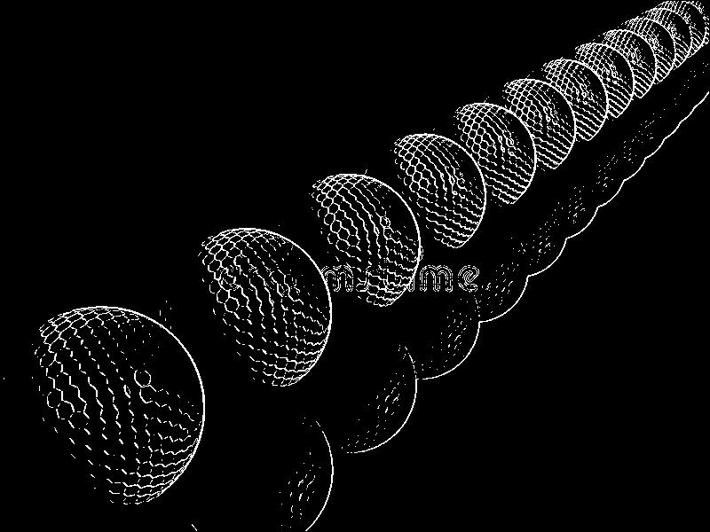
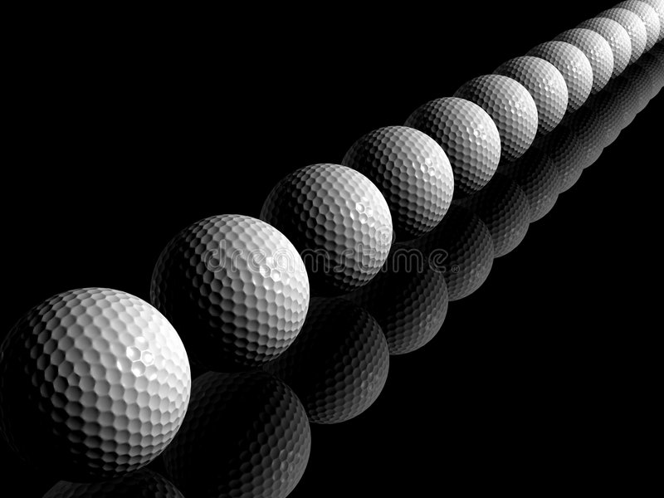

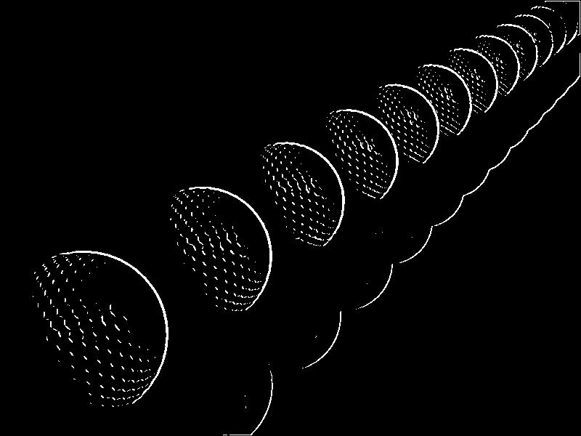
Design Overview
edge detect result without gaussian blur
source image
image after gaussian blur
edge detect result with gaussian blur
Edge detector function
Gaussian Blur is necessary
Edge detector is a good fit for ASIC design
2
Notes:
Haobo Chen

Slide 3
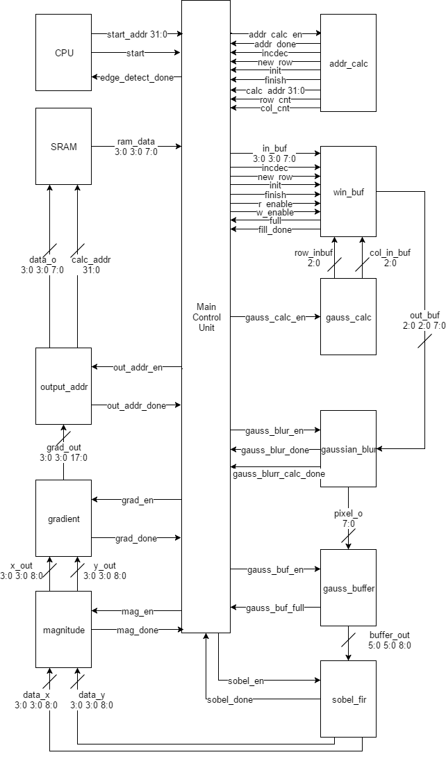
Design Overview
Edge detector function
Gaussian Blur is necessary
Edge detector is a good fit for ASIC design
2

Slide 4
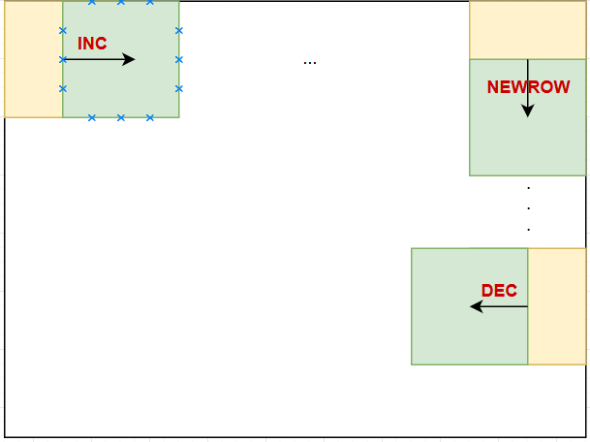
Address Calculation and Window Buffer
Address Calculation module functionality
Window Buffer operation
3
Notes:
Haobo Chen

Slide 5
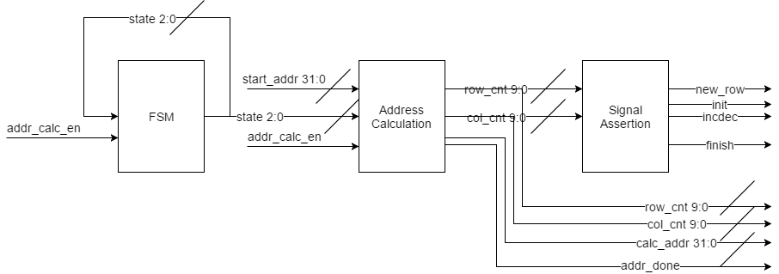
Address Calculation and Window Buffer
Address Calculation module functionality
Window Buffer operation
3
Notes:
Haobo Chen

Slide 6
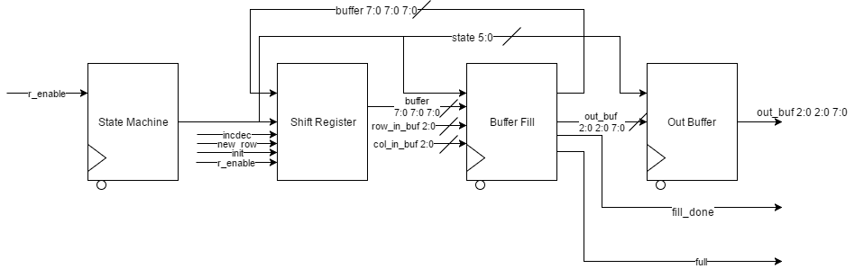
Address Calculation and Window Buffer
Address Calculation module functionality
Window Buffer operation
3

Slide 7
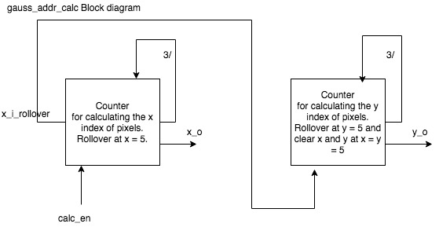
Gaussian Blur Function blocks
Gaussian address calculator
Gaussian blur calculator
Gaussian buffer
4
Notes:
Haoming Zhang

Slide 8
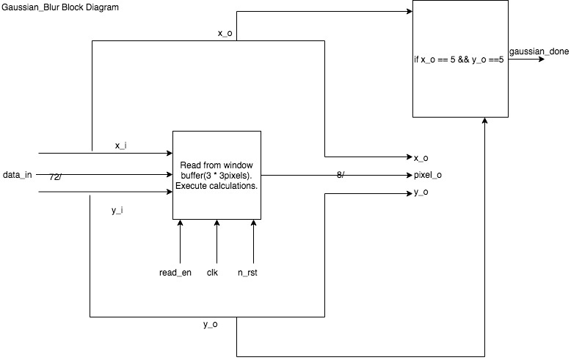
Gaussian Blur Function blocks
Gaussian address calculator
Gaussian blur calculator
Gaussian buffer
4
Notes:
Haoming Zhang

Slide 9
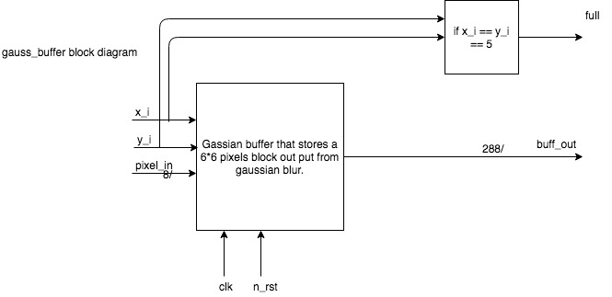
Gaussian Blur Function blocks
Gaussian address calculator
Gaussian blur calculator
Gaussian buffer
4
Notes:
Haoming Zhang

Slide 10
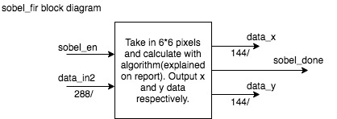
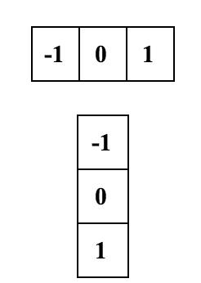
Sobel Filter Function Block
5
Notes:
Haoming Zhang

Slide 11
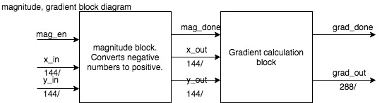
Magnitude and Gradient Block
6
Notes:
Ni Kang

Slide 12
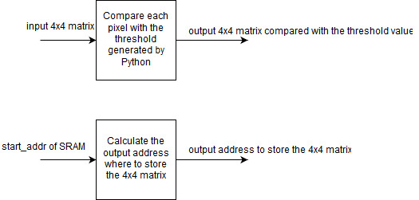
Output Address Block
7

Slide 13
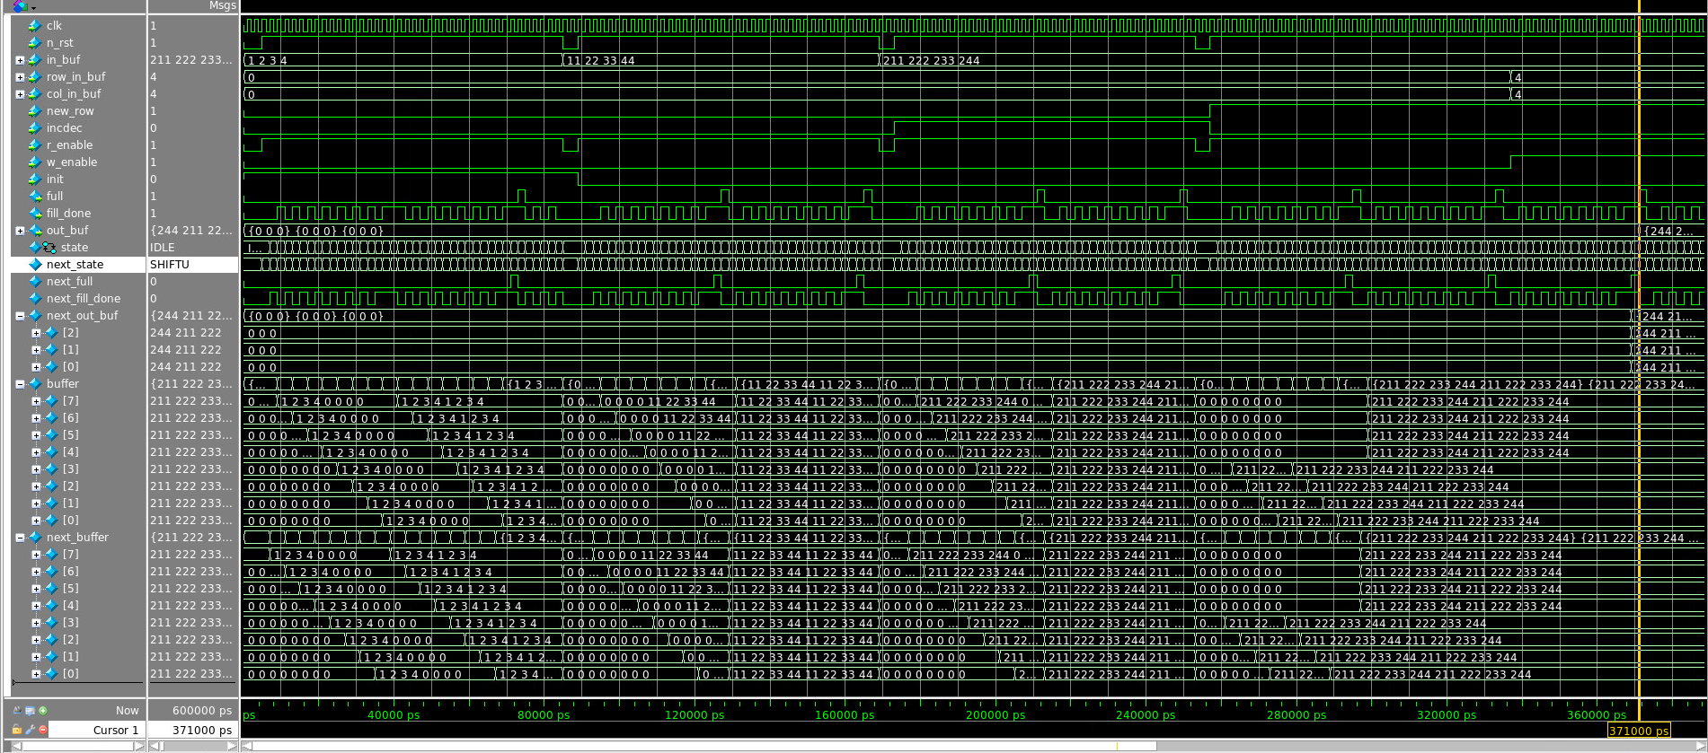
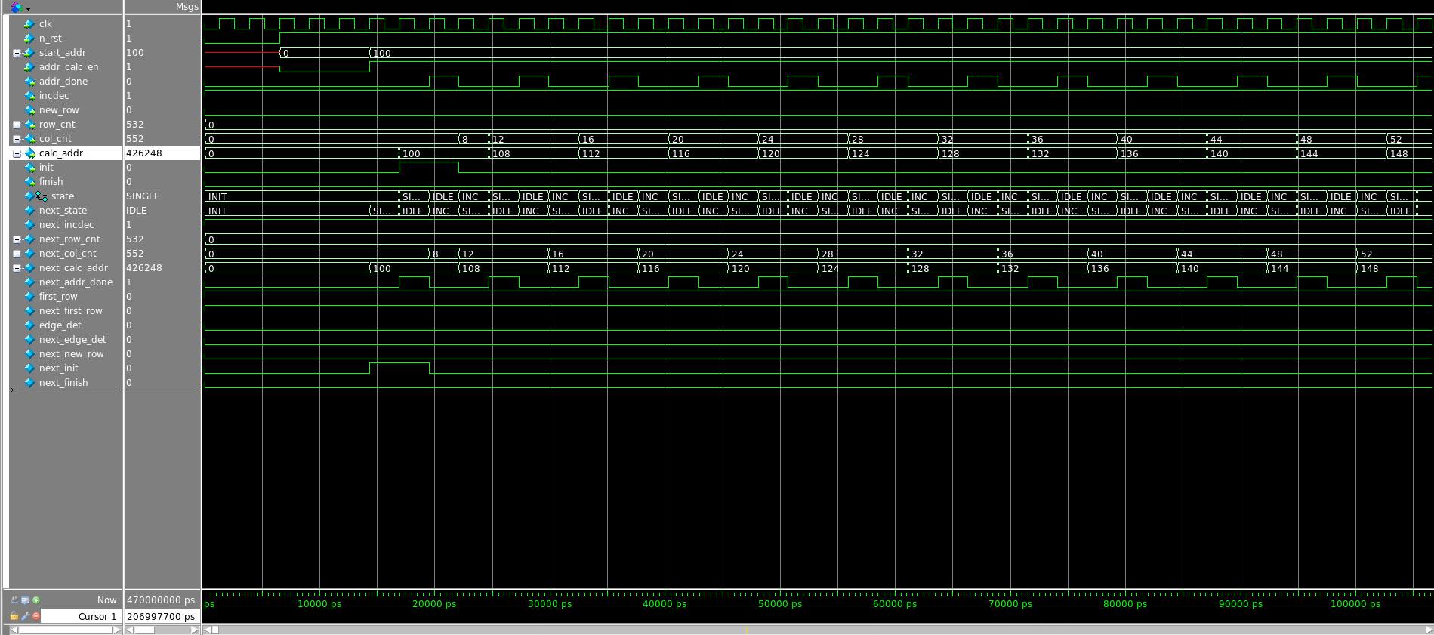
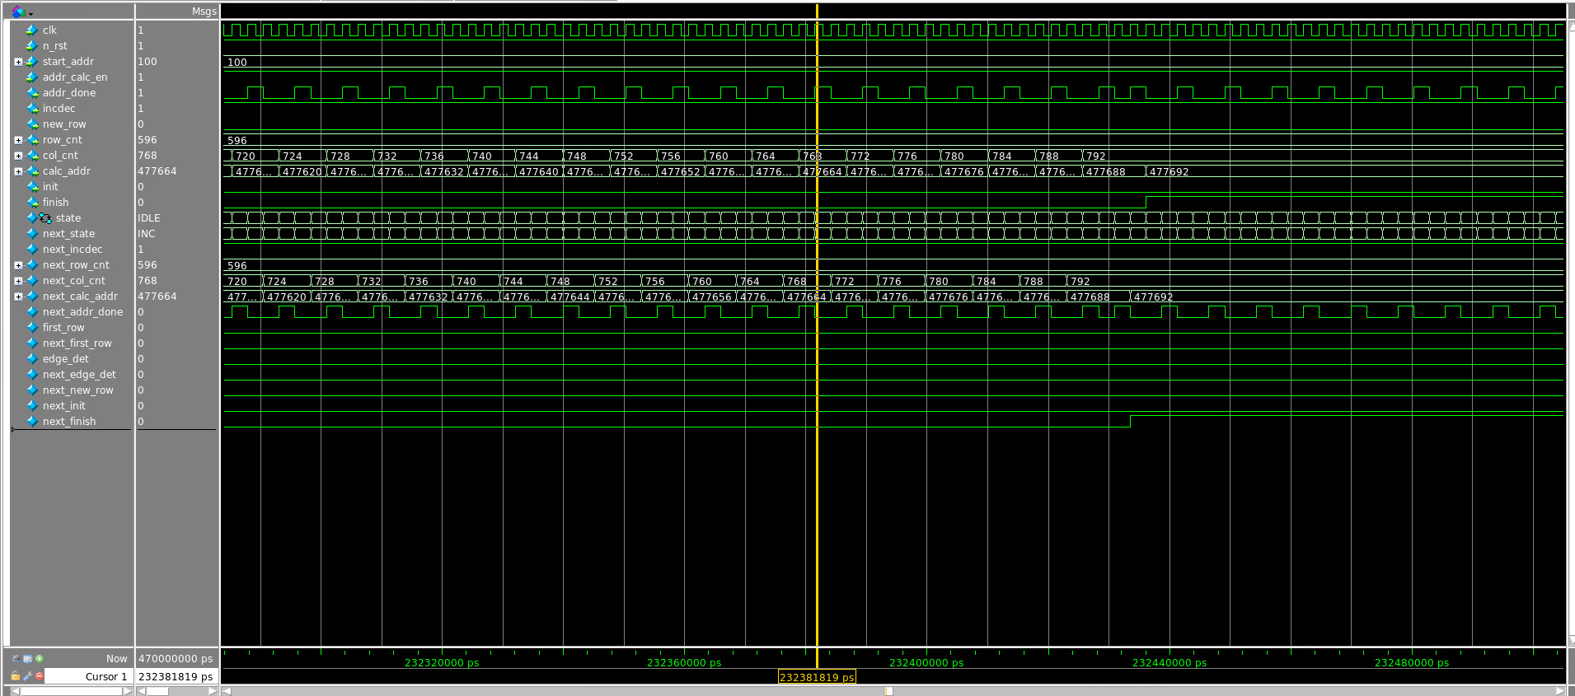
Address Calculation and Window Buffer Results
0, 0, 0, 0, 0, 0, 0, 0
0, 0, 0, 0, 0, 0, 0, 0
0, 0, 0, 0, 0, 0, 0, 0
0, 0, 0, 0, 0, 0, 0, 0
0, 0, 0, 0, 0, 0, 0, 0
0, 0, 0, 0, 0, 0, 0, 0
0, 0, 0, 0, 0, 0, 0, 0
0, 0, 0, 0, 0, 0, 0, 0
8
Notes:
Haobo Chen

Slide 14
Address Calculation and Window Buffer Results
1, 2, 3, 4, 0, 0, 0, 0
0, 0, 0, 0, 0, 0, 0, 0
0, 0, 0, 0, 0, 0, 0, 0
0, 0, 0, 0, 0, 0, 0, 0
0, 0, 0, 0, 0, 0, 0, 0
0, 0, 0, 0, 0, 0, 0, 0
0, 0, 0, 0, 0, 0, 0, 0
0, 0, 0, 0, 0, 0, 0, 0
0, 0, 0, 0, 0, 0, 0, 0
0, 0, 0, 0, 0, 0, 0, 0
0, 0, 0, 0, 0, 0, 0, 0
0, 0, 0, 0, 0, 0, 0, 0
0, 0, 0, 0, 0, 0, 0, 0
0, 0, 0, 0, 0, 0, 0, 0
0, 0, 0, 0, 0, 0, 0, 0
0, 0, 0, 0, 0, 0, 0, 0
8
Notes:
Haobo Chen

Slide 15
Address Calculation and Window Buffer Results
1, 2, 3, 4, 0, 0, 0, 0
0, 0, 0, 0, 0, 0, 0, 0
0, 0, 0, 0, 0, 0, 0, 0
0, 0, 0, 0, 0, 0, 0, 0
0, 0, 0, 0, 0, 0, 0, 0
0, 0, 0, 0, 0, 0, 0, 0
0, 0, 0, 0, 0, 0, 0, 0
0, 0, 0, 0, 0, 0, 0, 0
1, 2, 3, 4, 0, 0, 0, 0
1, 2, 3, 4, 0, 0, 0, 0
0, 0, 0, 0, 0, 0, 0, 0
0, 0, 0, 0, 0, 0, 0, 0
0, 0, 0, 0, 0, 0, 0, 0
0, 0, 0, 0, 0, 0, 0, 0
0, 0, 0, 0, 0, 0, 0, 0
0, 0, 0, 0, 0, 0, 0, 0
0, 0, 0, 0, 0, 0, 0, 0
0, 0, 0, 0, 0, 0, 0, 0
0, 0, 0, 0, 0, 0, 0, 0
0, 0, 0, 0, 0, 0, 0, 0
0, 0, 0, 0, 0, 0, 0, 0
0, 0, 0, 0, 0, 0, 0, 0
0, 0, 0, 0, 0, 0, 0, 0
0, 0, 0, 0, 0, 0, 0, 0
8
Notes:
Haobo Chen

Slide 16
Address Calculation and Window Buffer Results
1, 2, 3, 4, 0, 0, 0, 0
0, 0, 0, 0, 0, 0, 0, 0
0, 0, 0, 0, 0, 0, 0, 0
0, 0, 0, 0, 0, 0, 0, 0
0, 0, 0, 0, 0, 0, 0, 0
0, 0, 0, 0, 0, 0, 0, 0
0, 0, 0, 0, 0, 0, 0, 0
0, 0, 0, 0, 0, 0, 0, 0
1, 2, 3, 4, 0, 0, 0, 0
1, 2, 3, 4, 0, 0, 0, 0
0, 0, 0, 0, 0, 0, 0, 0
0, 0, 0, 0, 0, 0, 0, 0
0, 0, 0, 0, 0, 0, 0, 0
0, 0, 0, 0, 0, 0, 0, 0
0, 0, 0, 0, 0, 0, 0, 0
0, 0, 0, 0, 0, 0, 0, 0
1, 2, 3, 4, 0, 0, 0, 0
1, 2, 3, 4, 0, 0, 0, 0
1, 2, 3, 4, 0, 0, 0, 0
0, 0, 0, 0, 0, 0, 0, 0
0, 0, 0, 0, 0, 0, 0, 0
0, 0, 0, 0, 0, 0, 0, 0
0, 0, 0, 0, 0, 0, 0, 0
0, 0, 0, 0, 0, 0, 0, 0
0, 0, 0, 0, 0, 0, 0, 0
0, 0, 0, 0, 0, 0, 0, 0
0, 0, 0, 0, 0, 0, 0, 0
0, 0, 0, 0, 0, 0, 0, 0
0, 0, 0, 0, 0, 0, 0, 0
0, 0, 0, 0, 0, 0, 0, 0
0, 0, 0, 0, 0, 0, 0, 0
0, 0, 0, 0, 0, 0, 0, 0
8
Notes:
Haobo Chen

Slide 17
Address Calculation and Window Buffer Results
1, 2, 3, 4, 0, 0, 0, 0
0, 0, 0, 0, 0, 0, 0, 0
0, 0, 0, 0, 0, 0, 0, 0
0, 0, 0, 0, 0, 0, 0, 0
0, 0, 0, 0, 0, 0, 0, 0
0, 0, 0, 0, 0, 0, 0, 0
0, 0, 0, 0, 0, 0, 0, 0
0, 0, 0, 0, 0, 0, 0, 0
1, 2, 3, 4, 0, 0, 0, 0
1, 2, 3, 4, 0, 0, 0, 0
0, 0, 0, 0, 0, 0, 0, 0
0, 0, 0, 0, 0, 0, 0, 0
0, 0, 0, 0, 0, 0, 0, 0
0, 0, 0, 0, 0, 0, 0, 0
0, 0, 0, 0, 0, 0, 0, 0
0, 0, 0, 0, 0, 0, 0, 0
1, 2, 3, 4, 0, 0, 0, 0
1, 2, 3, 4, 0, 0, 0, 0
1, 2, 3, 4, 0, 0, 0, 0
0, 0, 0, 0, 0, 0, 0, 0
0, 0, 0, 0, 0, 0, 0, 0
0, 0, 0, 0, 0, 0, 0, 0
0, 0, 0, 0, 0, 0, 0, 0
0, 0, 0, 0, 0, 0, 0, 0
1, 2, 3, 4, 1, 2, 3, 4
1, 2, 3, 4, 1, 2, 3, 4
1, 2, 3, 4, 1, 2, 3, 4
1, 2, 3, 4, 1, 2, 3, 4
1, 2, 3, 4, 1, 2, 3, 4
1, 2, 3, 4, 1, 2, 3, 4
1, 2, 3, 4, 1, 2, 3, 4
1, 2, 3, 4, 1, 2, 3, 4
0, 0, 0, 0, 0, 0, 0, 0
0, 0, 0, 0, 0, 0, 0, 0
0, 0, 0, 0, 0, 0, 0, 0
0, 0, 0, 0, 0, 0, 0, 0
0, 0, 0, 0, 0, 0, 0, 0
0, 0, 0, 0, 0, 0, 0, 0
0, 0, 0, 0, 0, 0, 0, 0
0, 0, 0, 0, 0, 0, 0, 0
8
Notes:
Haobo Chen

Slide 18
Gaussian Blur waveforms
9
Notes:
Haoming Zhang

Slide 19
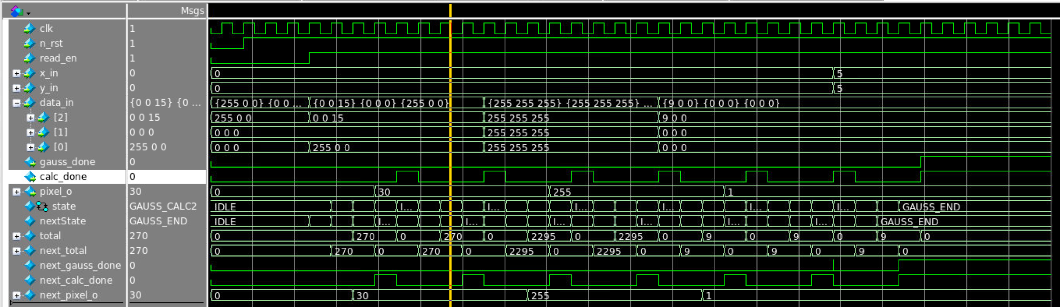
Gaussian Blur waveforms
0 0 15
0 0 0
255 0 0
270 / 9 = 30
9
Notes:
Haoming Zhang

Slide 20
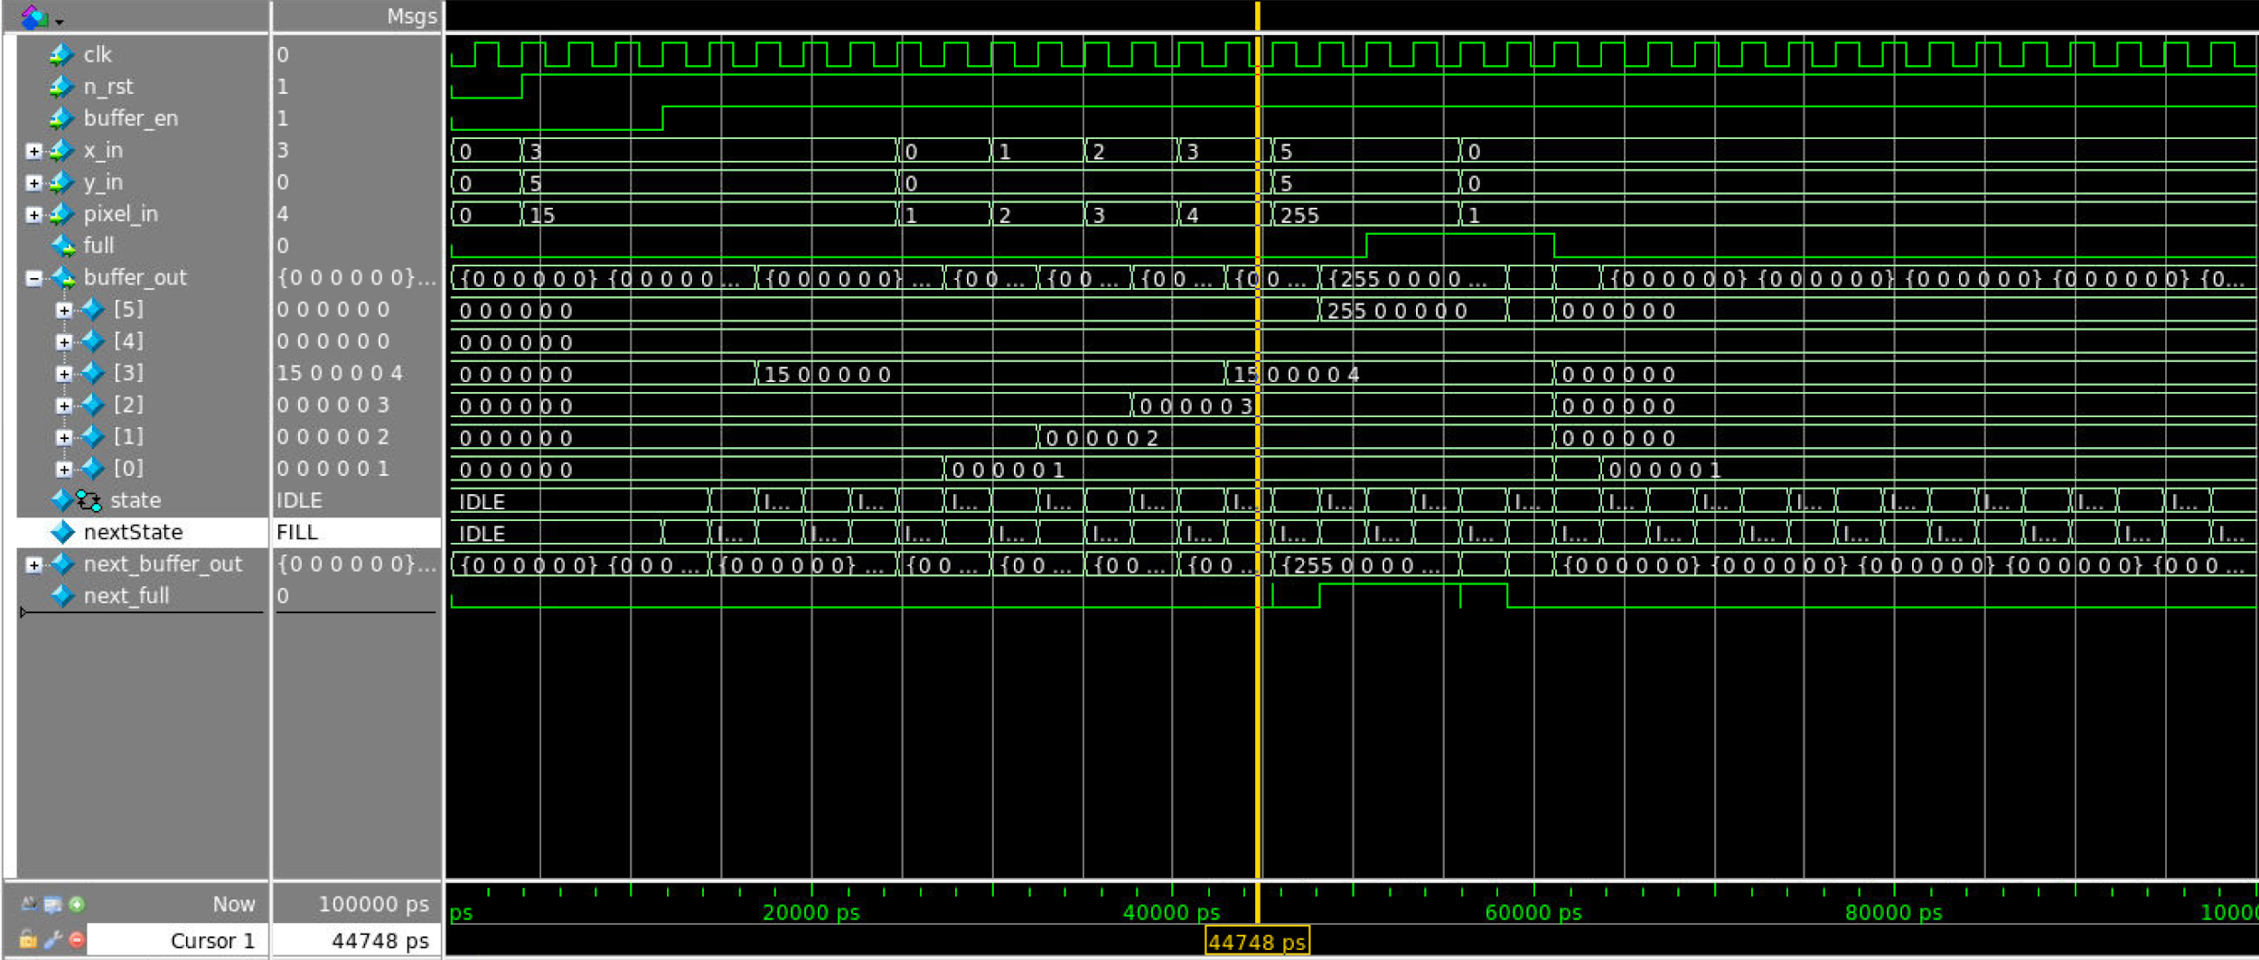
Gaussian Blur waveforms
x = 3, y = 0
pixel_in = 4
0 0 0 0 0 0
0 0 0 0 0 0
15 0 0 0 0 4
0 0 0 0 0 3
0 0 0 0 0 2
0 0 0 0 0 1
270 / 9 = 30
9
Notes:
Haoming Zhang

Slide 21
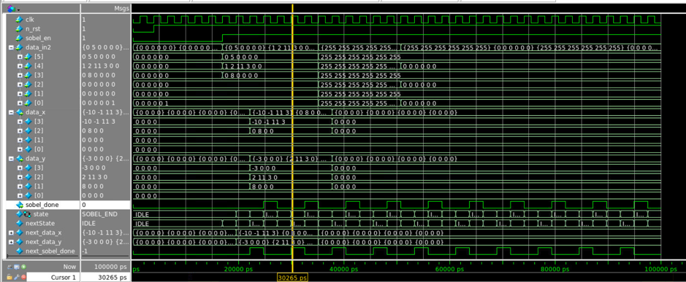
Sobel filter waveform
0 5 0 0 0 0
1 2 11 3 0 0
0 8 0 0 0 0
0 0 0 0 0 0
0 0 0 0 0 0
0 0 0 0 1 0
-10 -1 11 3
0 8 0 0
0 0 0 0
0 0 0 0
-3 0 0 0
2 11 3 0
8 0 0 0
0 0 0 0
10
Notes:
Haoming Zhang

Slide 22
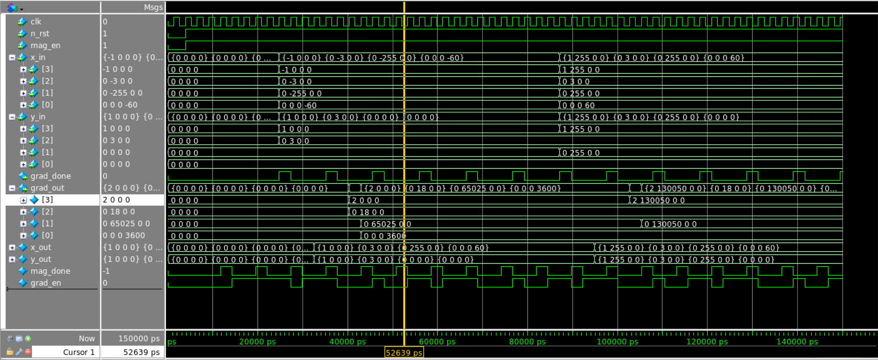
Magnitude and Gradient Waveform
-1 0 0 0 1 0 0 0
0 -3 0 0 0 3 0 0
0 -255 0 0 0 0 0 0
0 0 0 -60 0 0 0 0
2 0 0 0
0 18 0 0
0 65025 0 0
0 0 0 3600
11
Notes:
Ni Kang

Slide 23
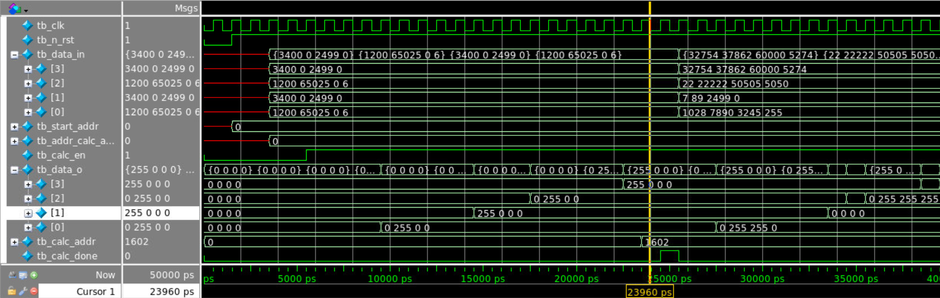
Output Address Waveform
3400 0 2499 0
1200 65025 0 6
3400 0 2499 0
1200 65025 0 6
255 0 0 0
0 255 0 0
255 0 0 0
0 255 0 0
12
Notes:
Ni Kang

Slide 24
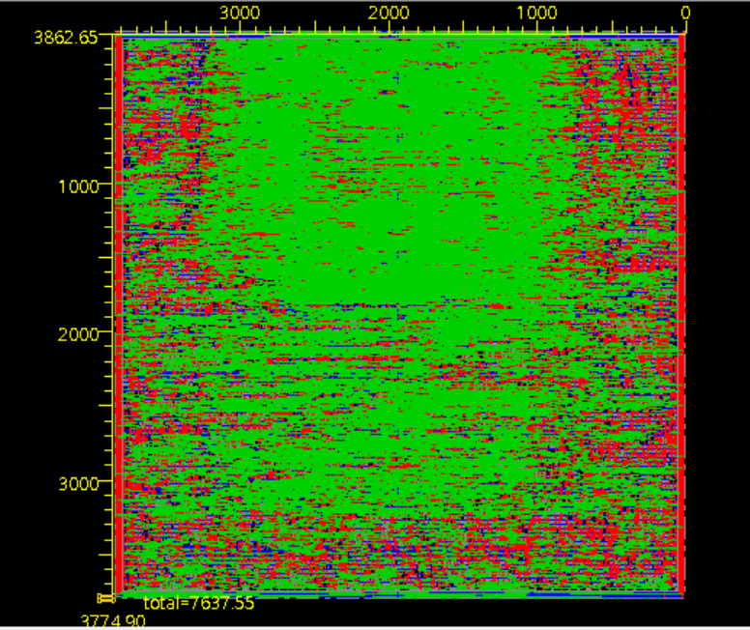
Layout of the Design
13
Notes:
Ni Kang
Area and Timing

Slide 25
Conclusion
Challenge
If we do it over again, …
Improvement
14
Notes:
Ni Kang
Challenge:
Input image data
handshake and interface between each block
pipelining is difficult when we tried to figure out our Main Control Unit
If we do it over again, what approach to take to do it differently:
shrink the size of window buffer. Decrease the amount of data to be process each time in each one of our blocks.
Do the pipelining in order to increase the speed.
Improvement:
First one is definitely pipelining.
Change the image to RGB instead of grayscale.
Can process image with different sizes instead of fixed size.

